Slide 1
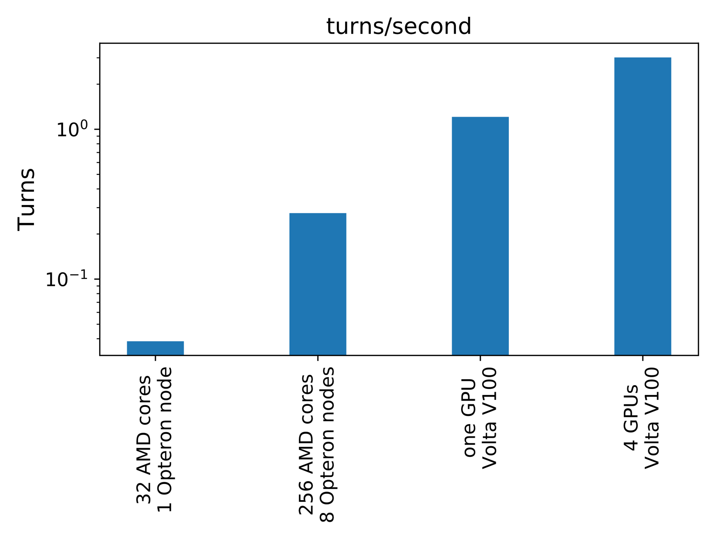
Accelerator Simulations at Scale Using GPUs
Scientific Achievement
Synergia accelerator simulation performance vastly improved with minimal development cost using the SciDAC/ASCR Kokkos toolset to access GPU computing resources
Significance and Impact
Enabling Synergia to seamlessly use GPU hardware makes meaningful beam dynamics simulations widely available and ensures that it is ready for new the new hybrid architectures at DOE computing facilities.
Research Details
Parallel operations are now handled by the Kokkos dispatch mechanism which automatically uses the appropriate thread execution technology for the CPU or GPU.
Particle data is kept in a Kokkos view object which can reside either in CPU or GPU memory.
The performance of a model accelerator simulation run with the identical Synergia codebase on similar cost CPU or GPU hardware that might be available to university researchers. The performance of the code running on four GPUs is about 500 times faster than running on CPUs.
Notes:
Notes: Include 200 word highlight summary….

