Slide 1
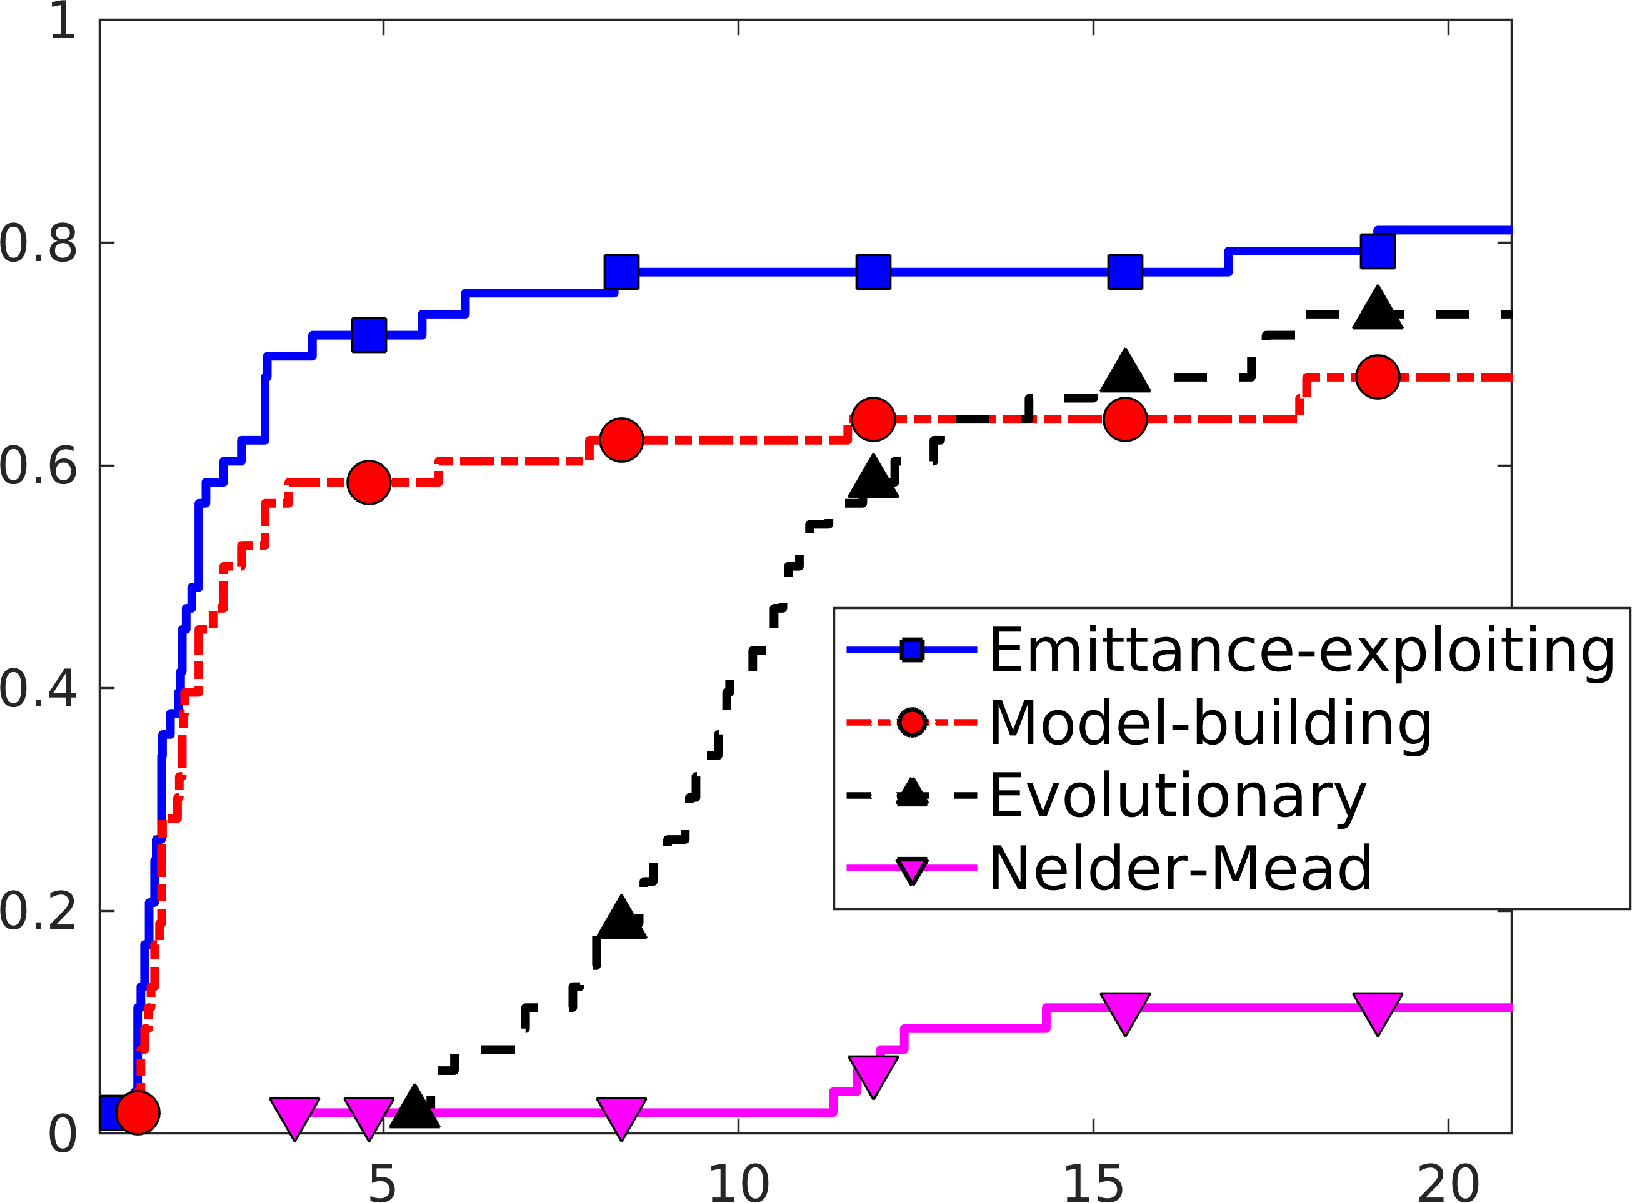
Algorithms for Optimizing Particle Accelerator Beam Emittance
New ComPASS4 algorithm
Scientific Achievement
New derivative-free numerical optimization algorithm to identify operational parameters that minimize beam emittance: a measure of spread of particles in an accelerator
Significance and Impact
Emittance is a key measure of beam quality and needs to be minimized in many particle accelerator applications
Research Details
ComPASS4's high-fidelity 3D accelerator simulations are computationally expensive
The new algorithm employs surrogate models of the simulation outputs S(x) and the emittance mapping e(S(x)) to better identify promising regions of the parameter space
Our algorithm exploits the structure in how emittance is calculated in order to find optimal parameters using fewer expensive simulations
Fraction of Problems Solved
Batches of Simulation Evaluations
Profiling on benchmark problems shows that exploiting how emittance is calculated improves the performance of our local model-building algorithm; increased parallelism and further improvements can be realized by using the new algorithm within a global multistart framework
ComPASS4
Khan, Larson, Wild. Manifold Sampling for Optimization of Nonconvex Functions that are Piecewise Linear Compositions of Smooth Components. SIAM J. Optimization, 2018
Notes:
Contact: Jeffrey Larson <jmlarson@anl.gov>
Stefan Wild <wild@mcs.anl.gov>
Research supported by HEP/ASCR SciDAC partnership ComPASS-4 (Community Project for Accelerator Science and Simulation 4).
Notes:
The P5 Report and the Report from the Topical Panel Meeting on Computing and
Simulations in High Energy Physics both highlight the significant cost of
accurately simulating particle accelerators. By exploiting the form of a very
common objective, our optimization algorithm requires fewer simulations to
identify optimal operational parameters. Such cost-effective computing
solutions are needed by scientists operating both conventional RF accelerators
and next-generation plasma accelerators.
Implementation currently being used to optimize particle simulations from UCLA,
the SLAC National Accelerator Laboratory, and the Argonne Wakefield Accelerator.
Links:
https://www.usparticlephysics.org/wp-content/uploads/2018/03/FINAL_P5_Report_053014.pdf
https://science.energy.gov/~/media/hep/pdf/files/Banner%20PDFs/Computing_Meeting_Report_final.pdf
https://epubs.siam.org/doi/abs/10.1137/15M1042097
https://iopscience.iop.org/article/10.1088/1742-6596/874/1/012062/meta
K. A. Khan, J. Larson, and S. M. Wild. Manifold sampling for optimization of nonconvex functions that are piecewise linear compositions of smooth components. SIAM Journal on Optimization 28(4), 2018, pp. 3001–3024. DOI : 10.1137/17m114741x

